Slide 1
How to Publish Articles Content
How to Create Issues
How to Submit & Publish Articles
How to Edit Journal Information

Slide 2
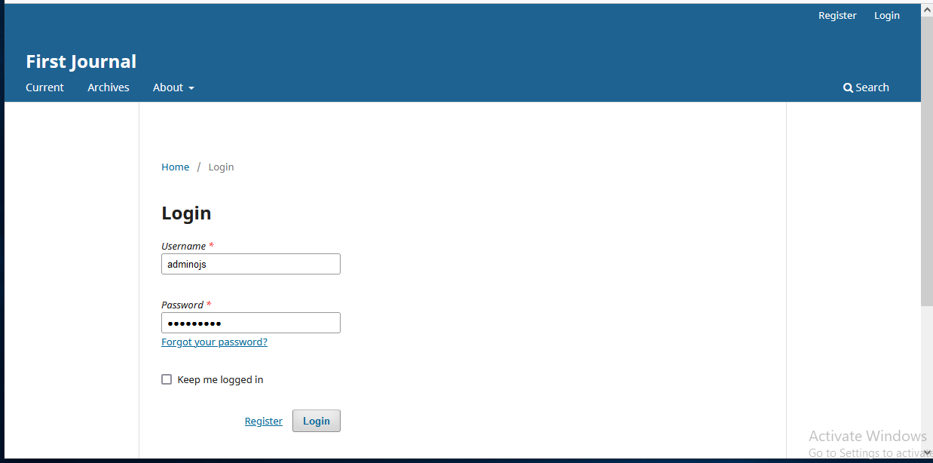
Login to the System

Slide 3
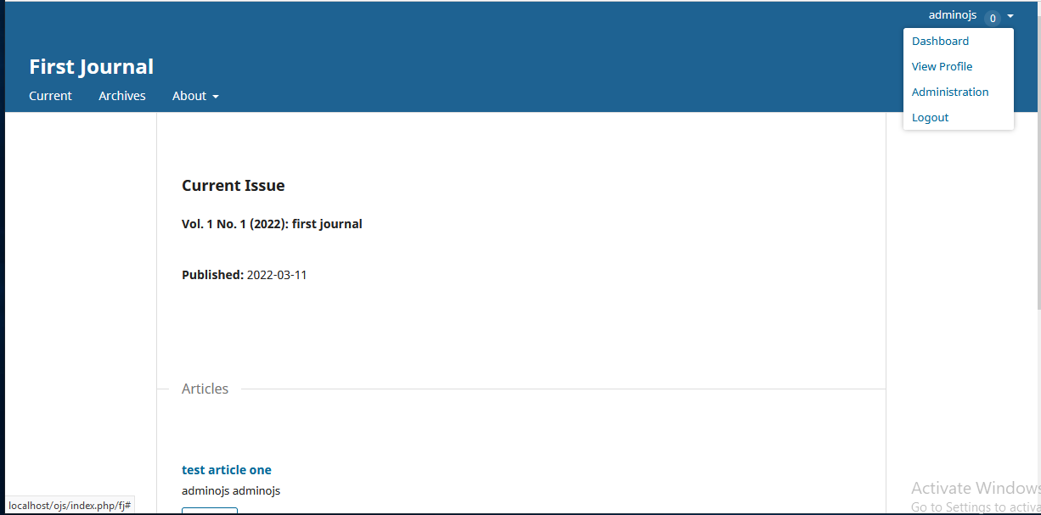
Go to the Dashboard

Slide 4
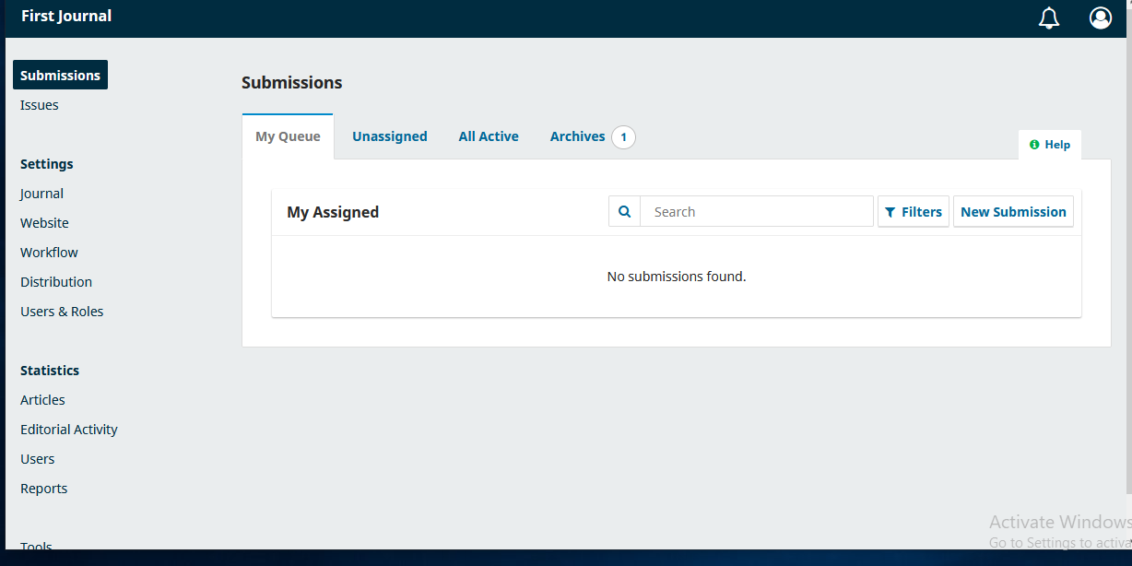
Go to Issues

Slide 5
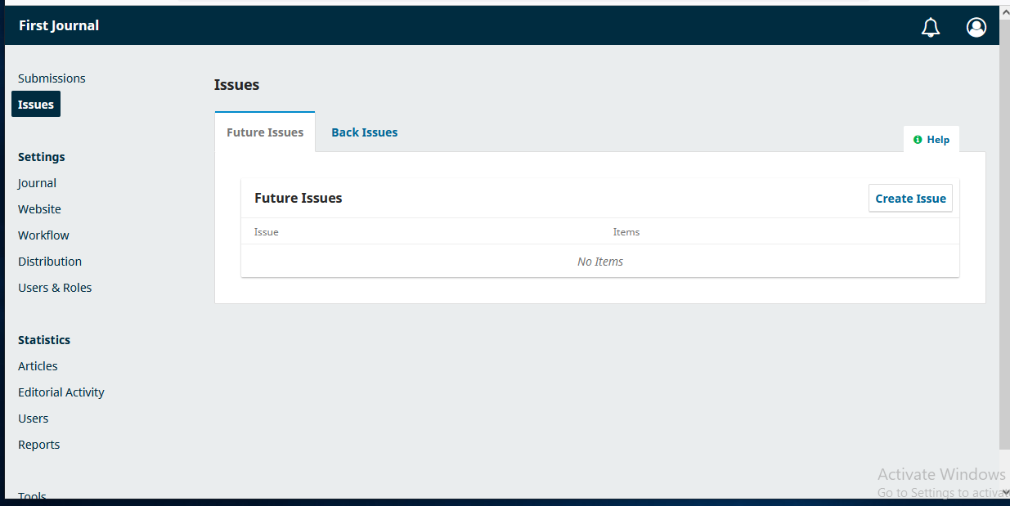
Enter in Create Issue

Slide 6
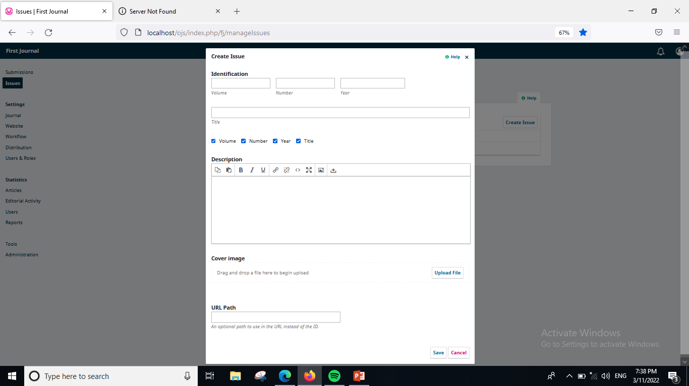
Insert Information of Issue

Slide 7
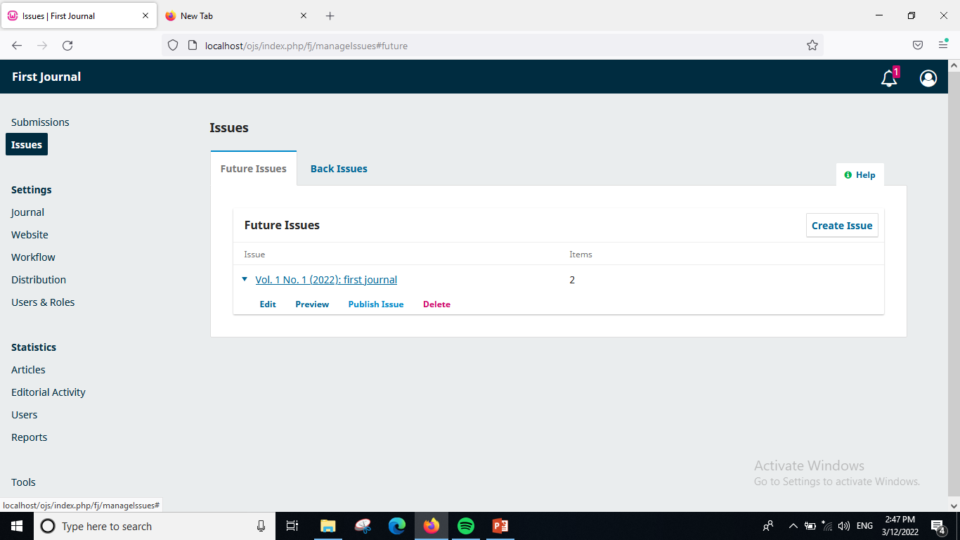
Cont..

Slide 8
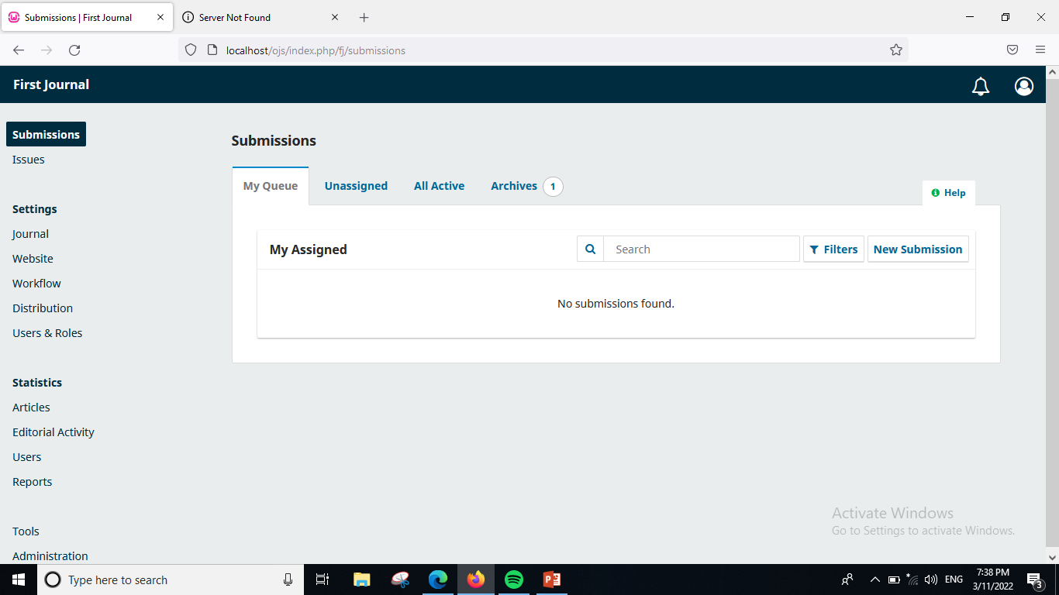
To Submit Article

Slide 9
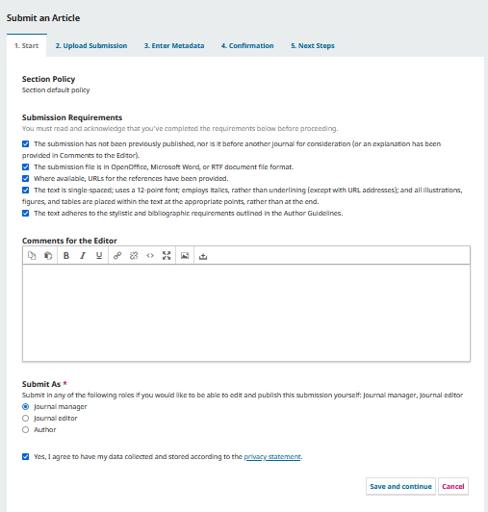
Step 1

Slide 10
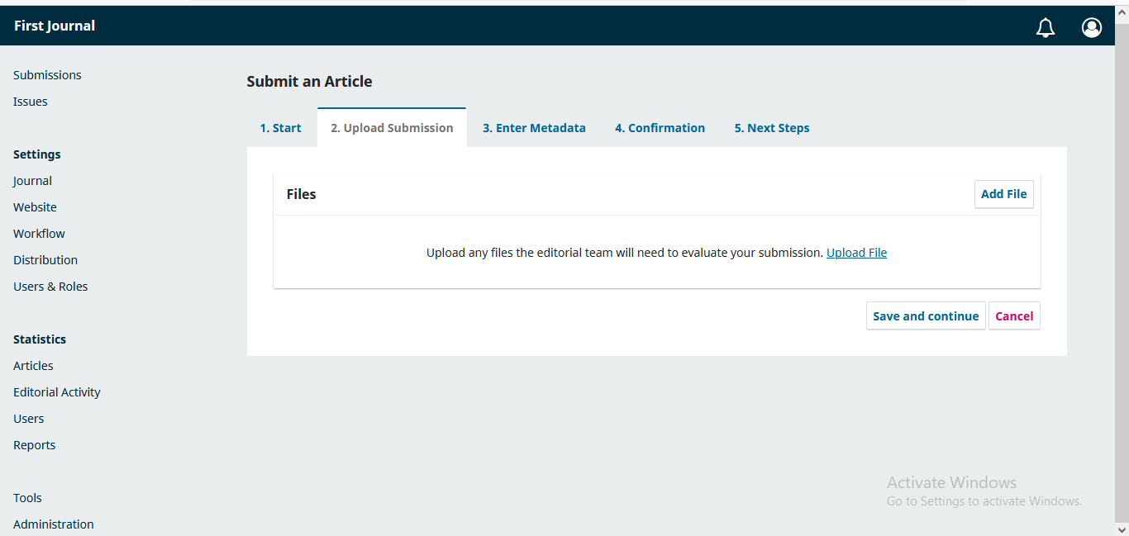
Step 2

Slide 11
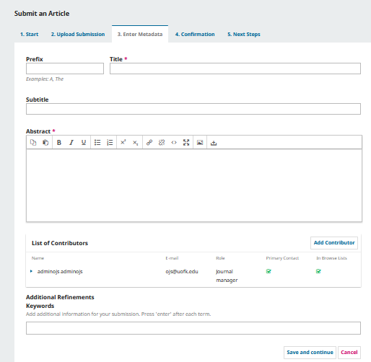
Step 3 Enter Metadata

Slide 12
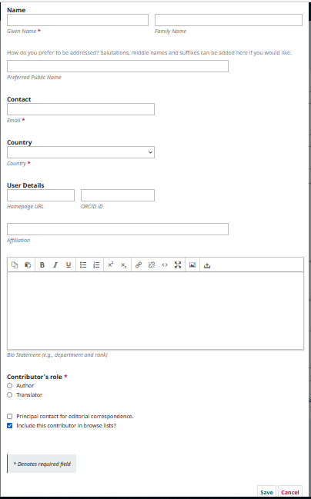
Cont.. Add Contributor

Slide 13
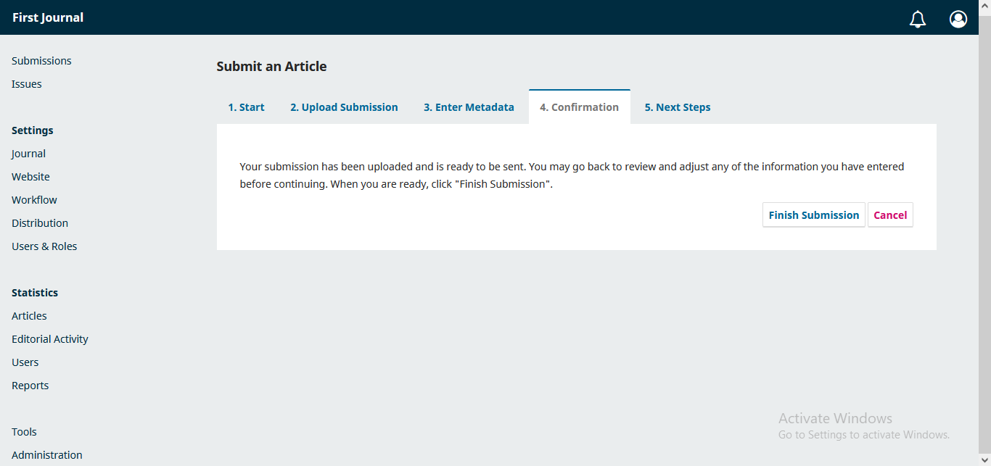
Step 4 Finish Submission

Slide 14
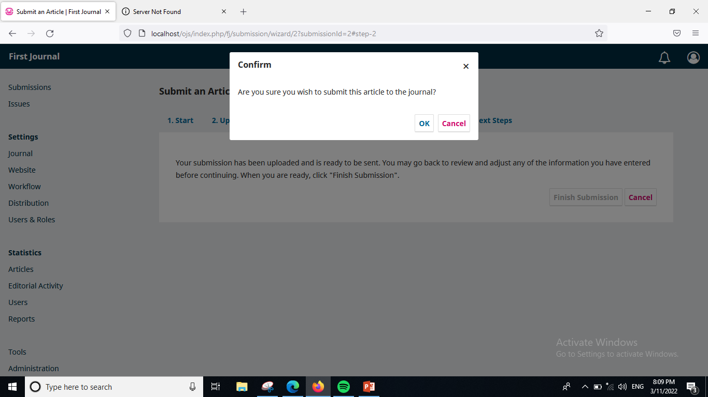
Cont..

Slide 15
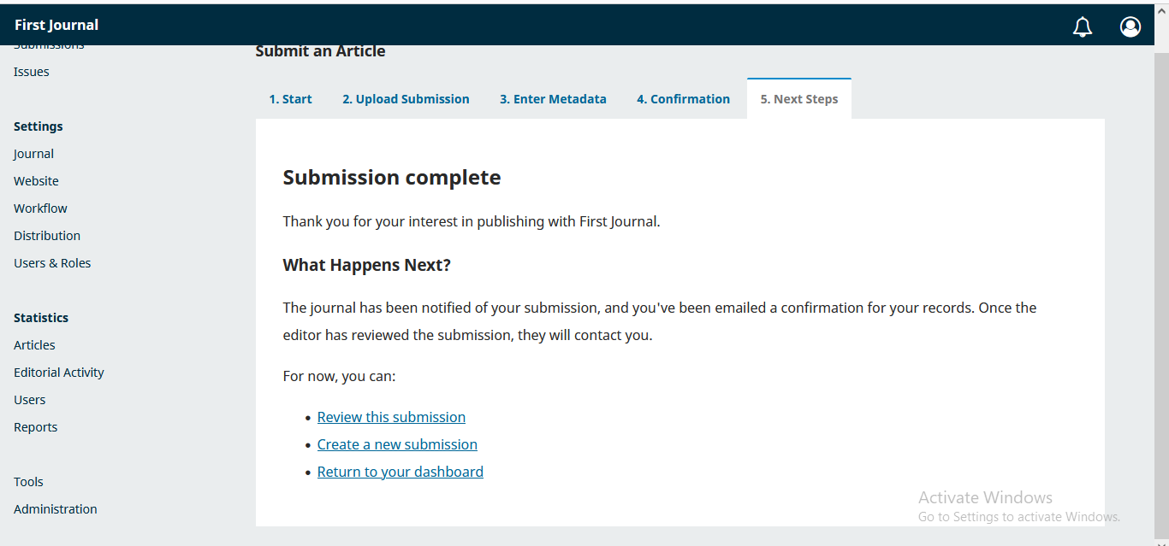
Next steps: Review this Submission

Slide 16
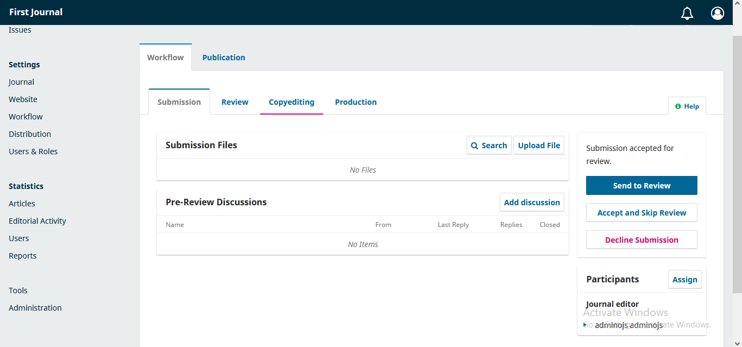
Editorial Decision

Slide 17
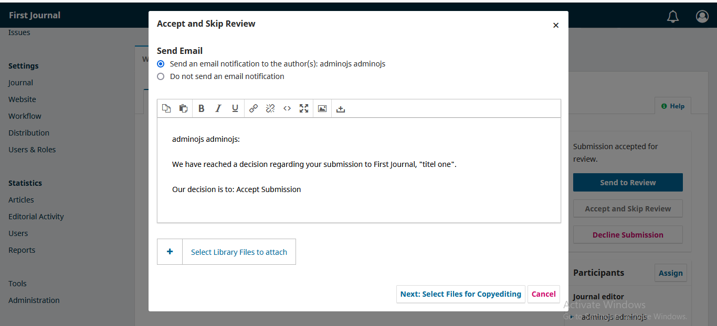
Cont..

Slide 18
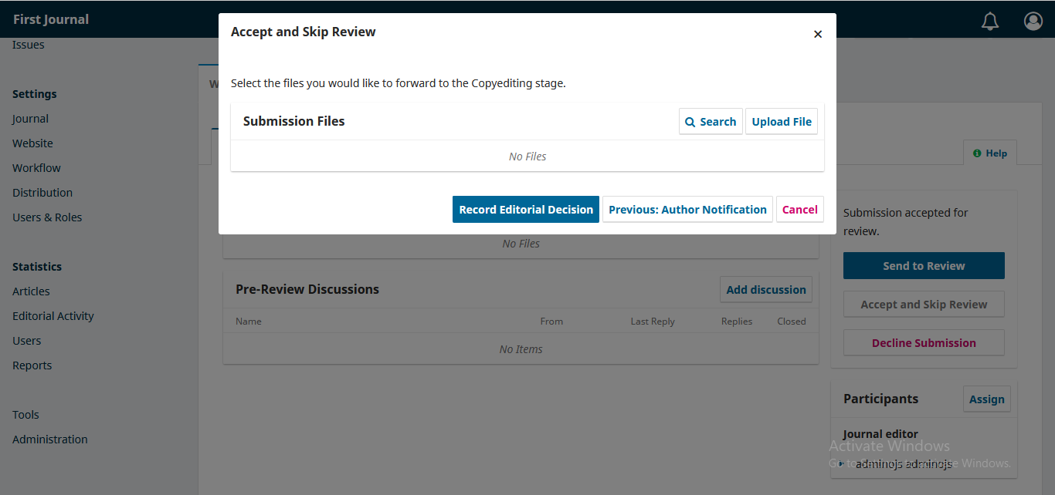
Record Editorial Decision

Slide 19
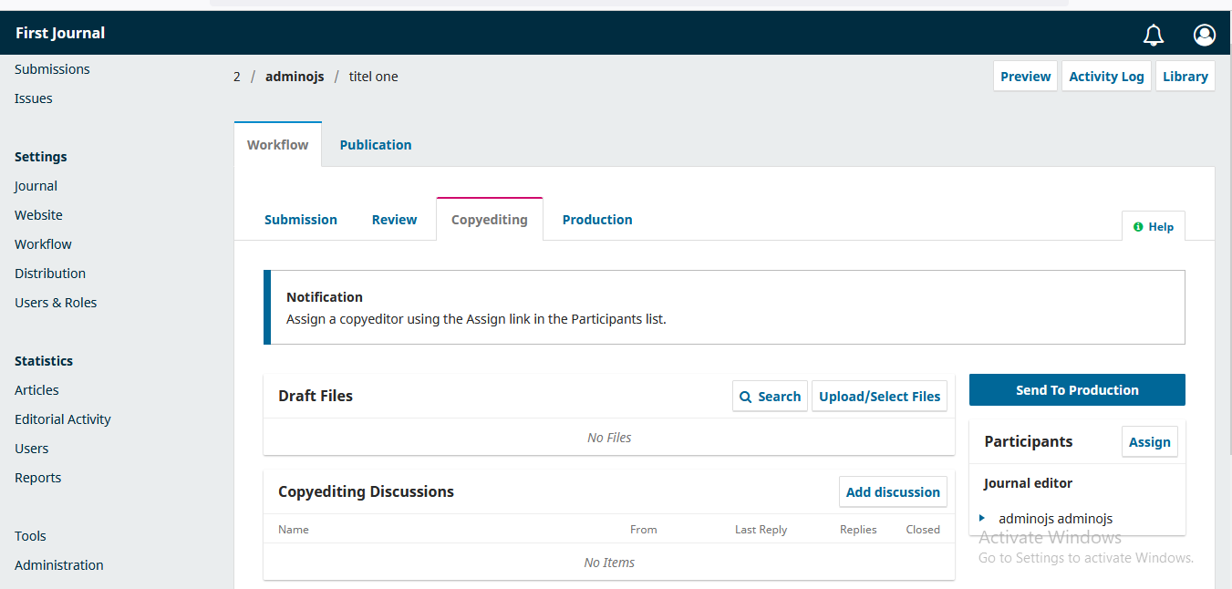
Send to Production

Slide 20
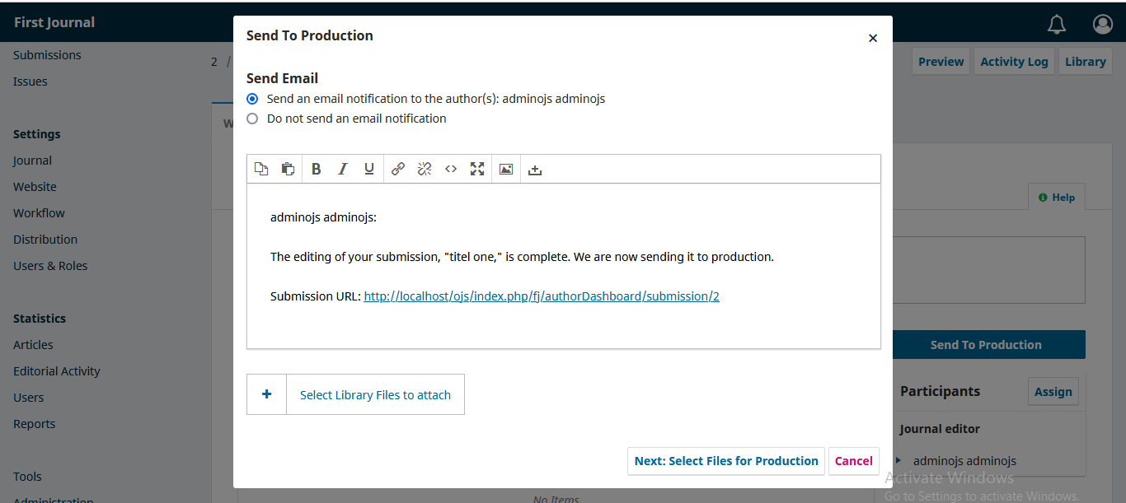
Cont..

Slide 21
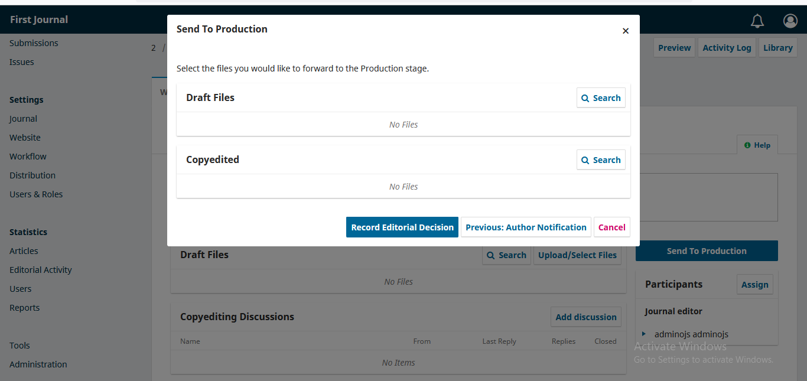
Send to Production

Slide 22
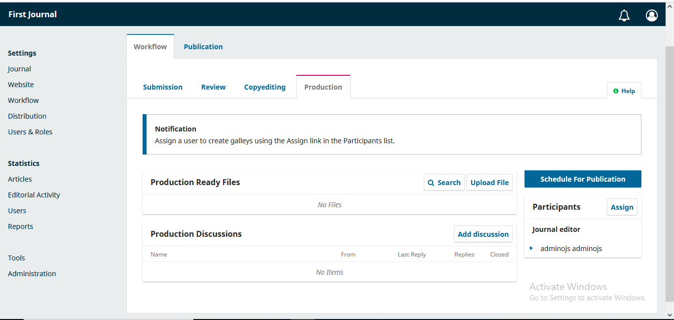
Schedule for Publication

Slide 23
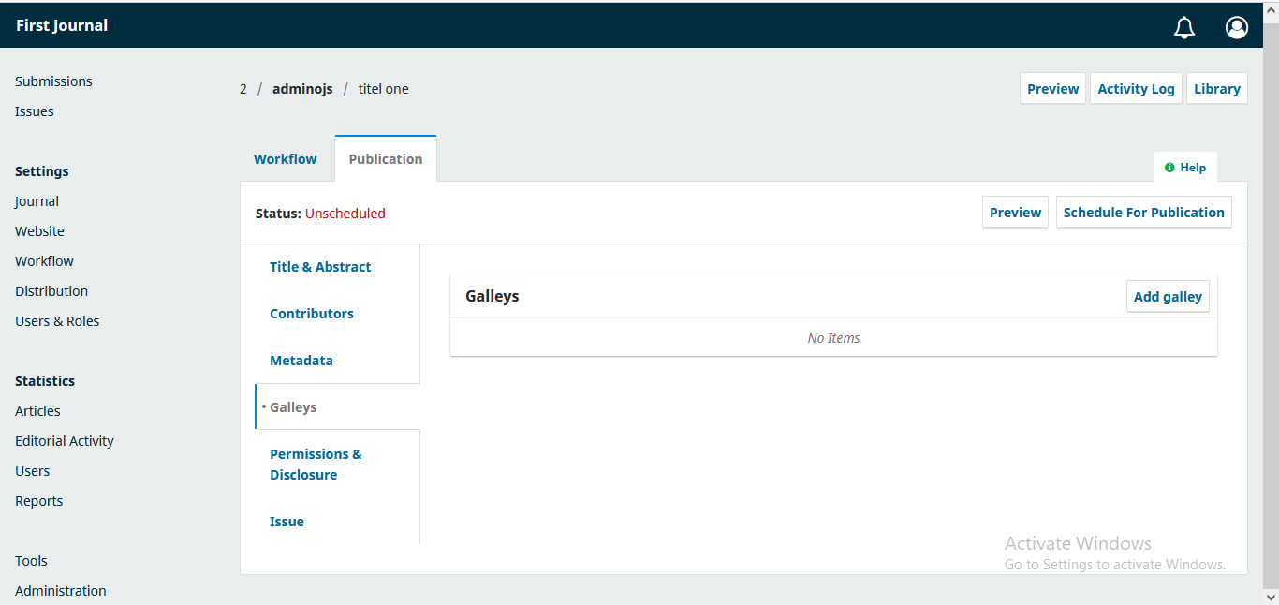
Add Article File

Slide 24
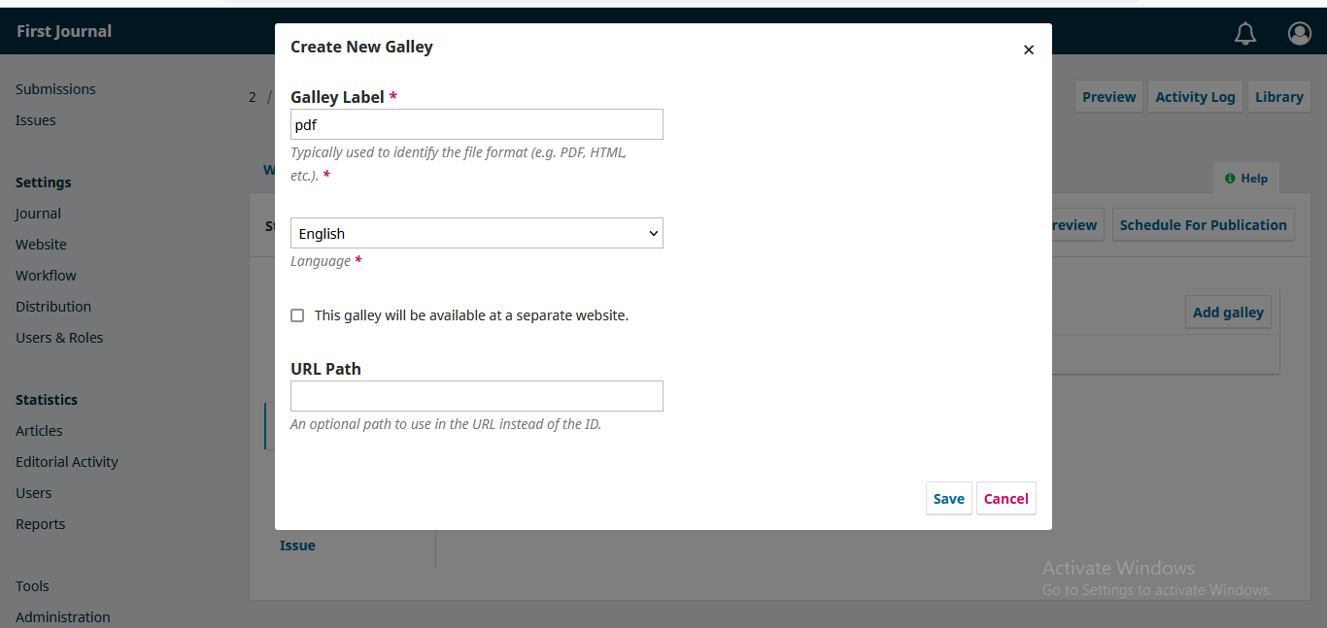
Cont.. Add file Format

Slide 25
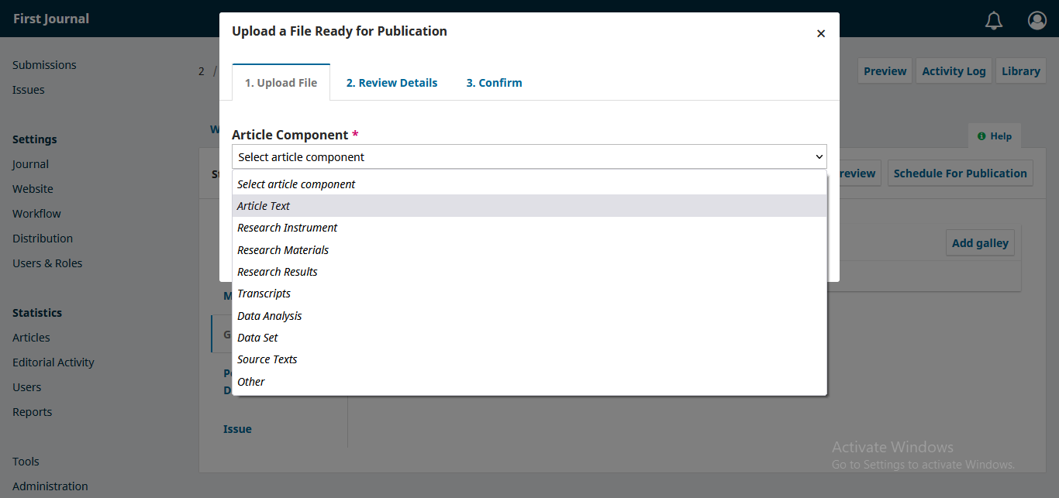
Step 1: select Article Component

Slide 26
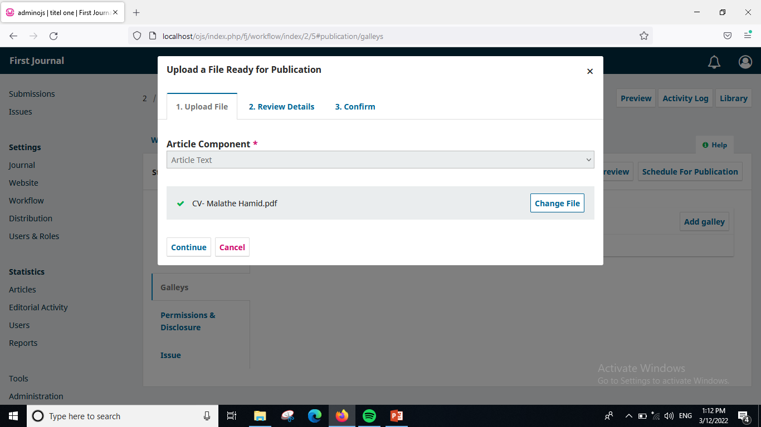
Cont. Upload File

Slide 27
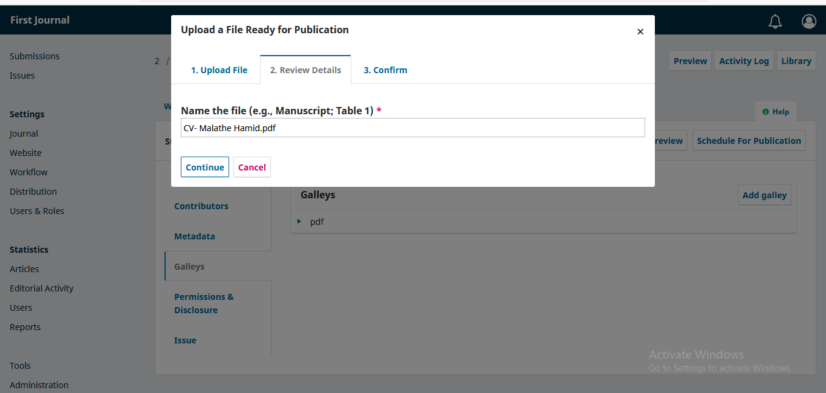
Step 2: Review File Name

Slide 28
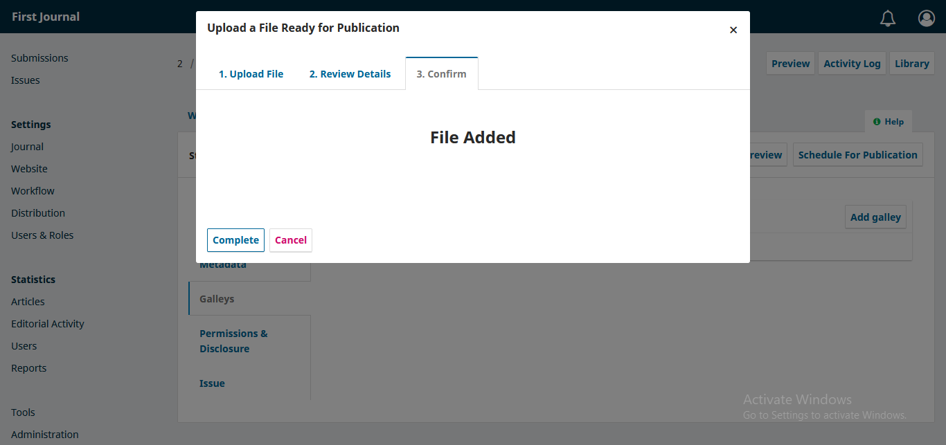
Step 3: Complete

Slide 29
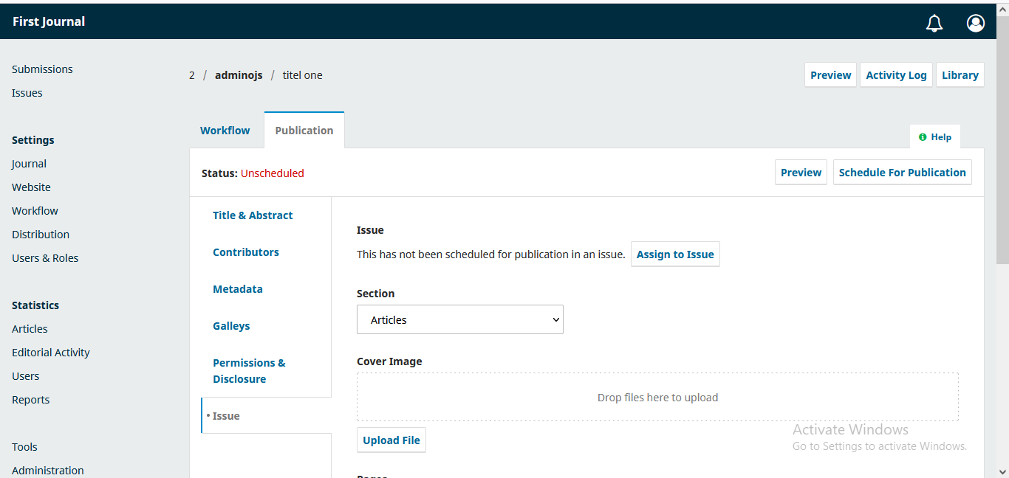
Assign to Issue

Slide 30
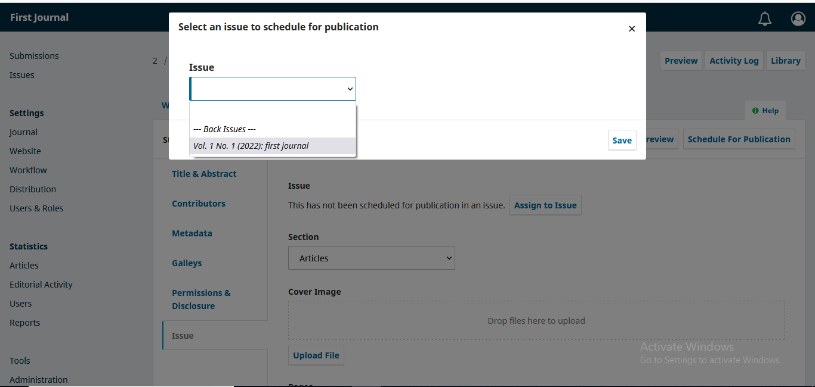
Select an Issue

Slide 31
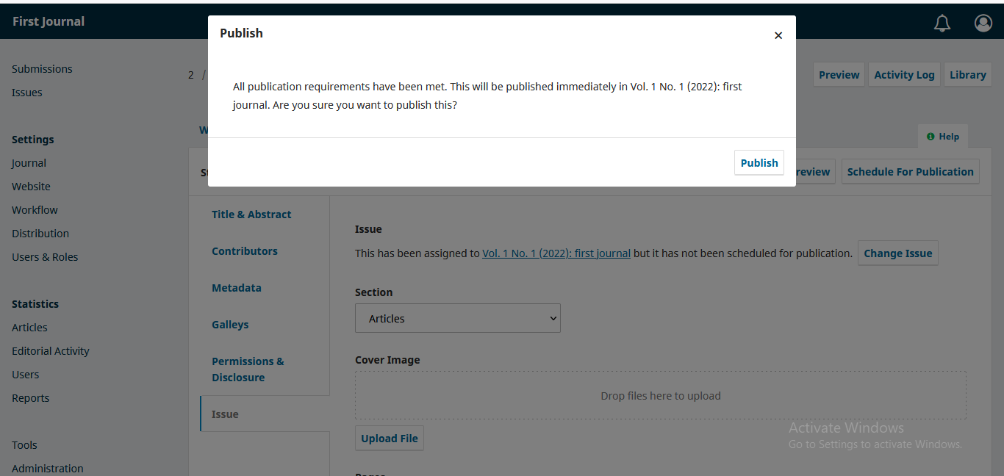
Publish

Slide 32
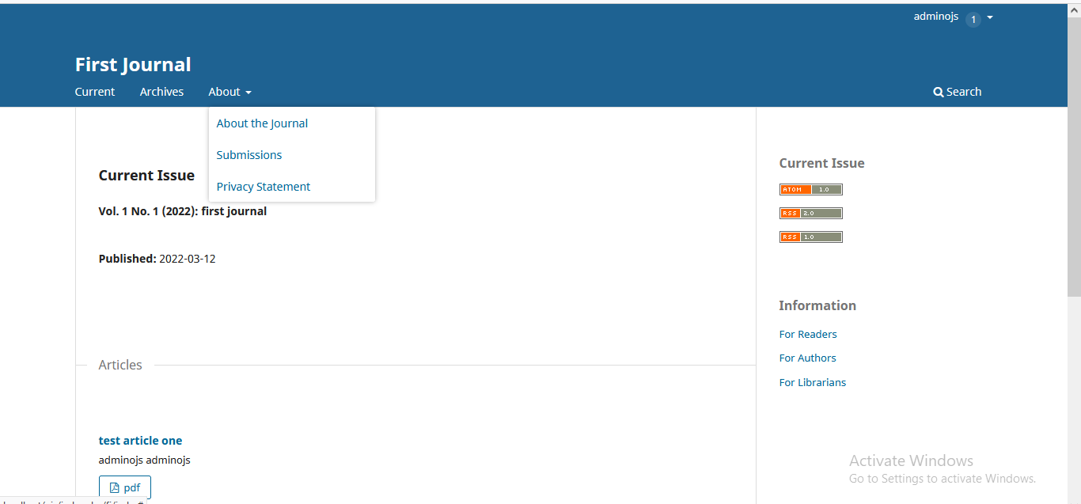
To Edit or Add About the Journal

Slide 33
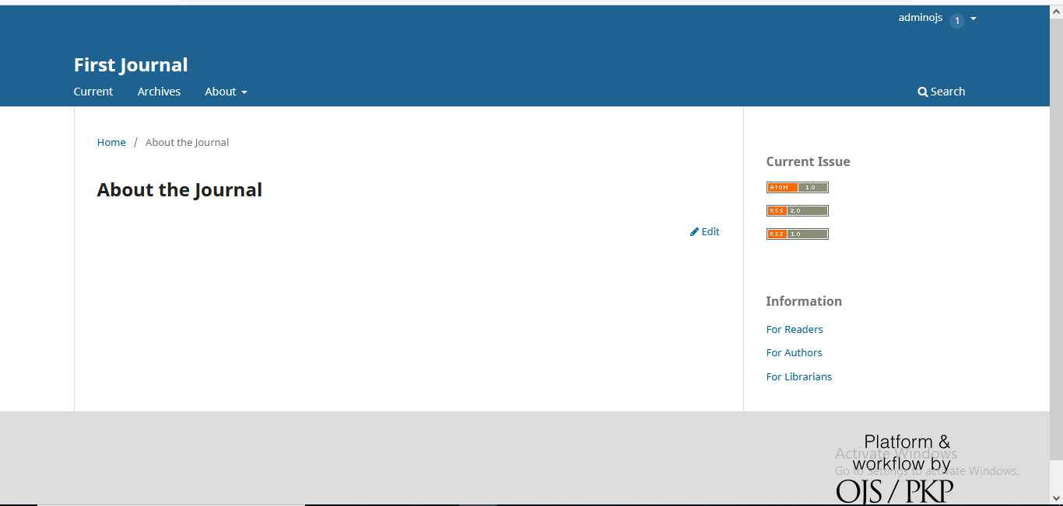
Click at Edit

Slide 34
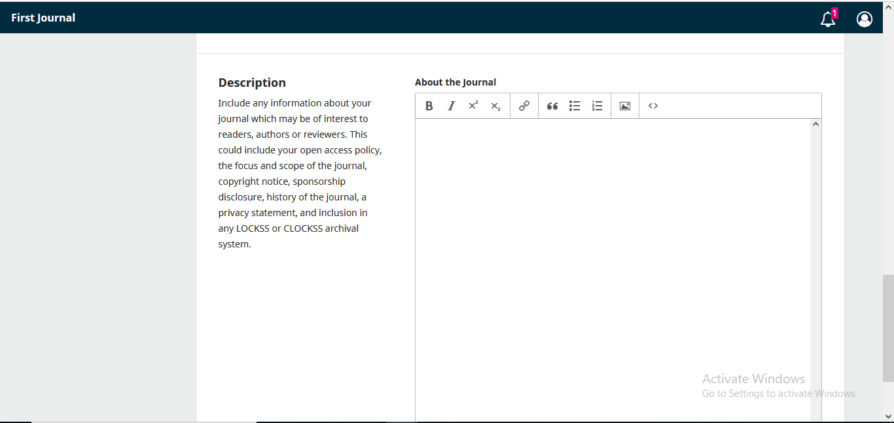
Cont..

Slide 35
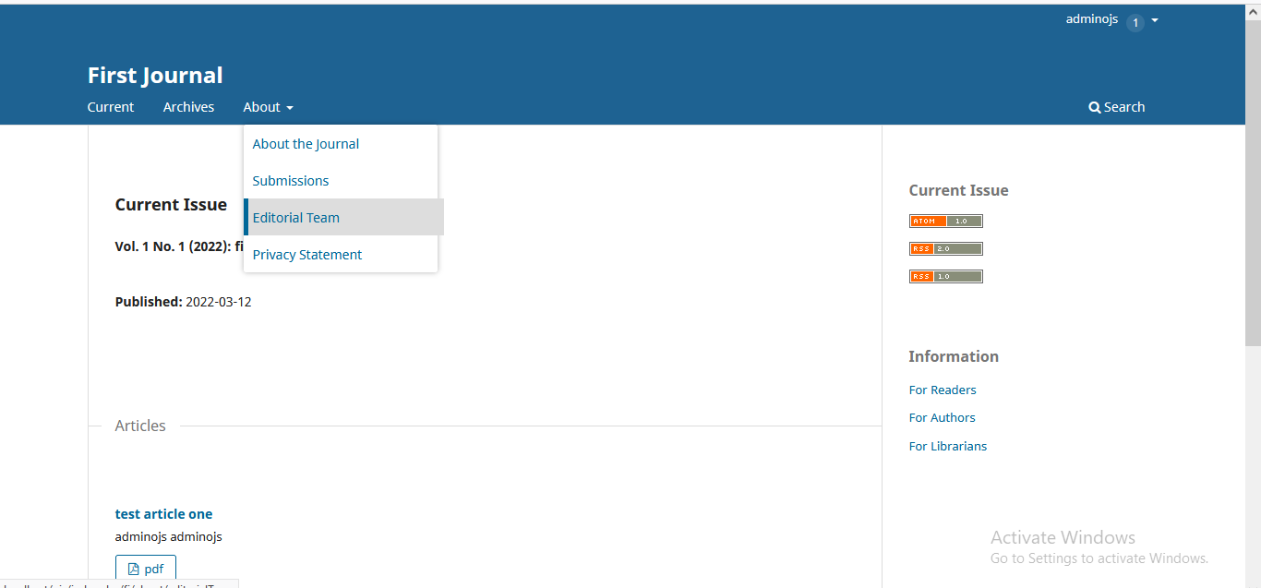
To Edit Editorial Team

Slide 36

Click at Edit

Slide 37
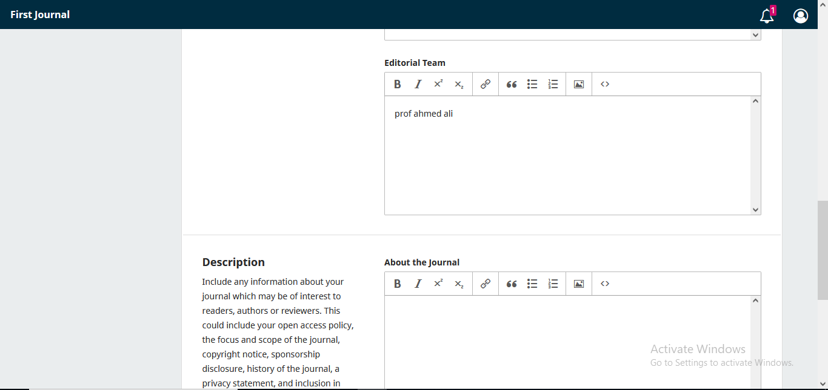
Edit Editorial Team

